Slide 1
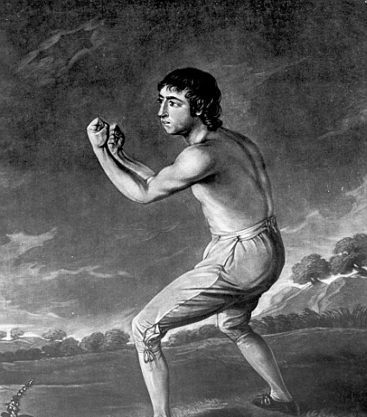
Orthodox versus Progressive Integration: The Debate Isn’t New
Mark Fox
Limmud, December 2019
markfox1959@gmail.com

Slide 2
Overview
Nineteenth century Jews faced pressures, both secular and religious, to assimilate
Jews chose different religious and secular paths in response
Religious response divided between traditional and reform
Secular response divided between isolationism and integration
Zionism was an alternative response, alongside others
Zangwill was a brilliant playwright caught between opposing forces
Examining Zangwill’s struggles as reflected in his play Transitional gives us pause for reflection for the present

Slide 3
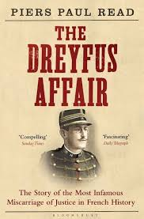
The Nineteenth Century For the Jews
Genuine sympathy – Napoleon (1806)/Lord Palmerston (1838-1840)
Regular antisemitic events HepHep (1819), Pogroms 1821, 1881/1884, Dreyfus Affair 1894-1906
Jews as pawns in superpower politics
Protestant messianism
Christian evangelism – Alexander McCaul (1799-1863) – “Old Paths - 1837”
An international Jewish conspiracy?
Are they irredeemably stubborn?

Slide 4
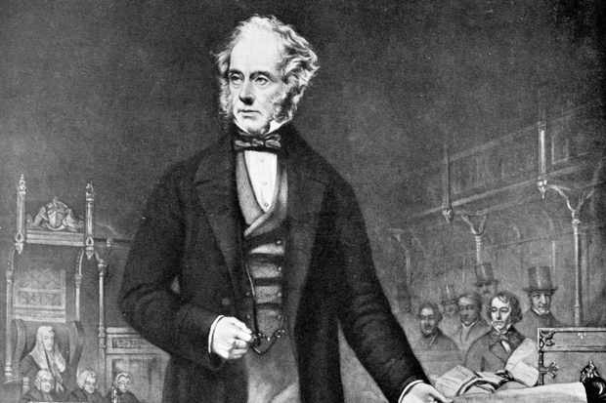
Nineteenth Century Christian Help for the Jews
Lord Palmerston appointing a consul to Jerusalem – 1838. Vice –Consul’s report:
. . . Like the miserable dog without an owner he is kicked by one because he crosses his path, and cuffed by another because he cries out-to seek redress he is afraid, lest it bring worse upon him; he thinks it better to endure than to live in the expectation of his complaint being revenged upon him. Brought up from infancy to look upon his civil disabilities everywhere as a mark of degradation, his heart becomes the cradle of fear and suspicion-he finds he is trusted by none-and therefore he lives himself without confidence in any.
Are we paranoid or is the world out to get us?

Slide 5
Palmerston in 1840
There exists at present among the Jews dispersed over Europe a strong notion that the time is approaching when their Nation is to return to Palestine; and consequently their wish to go thither has become more keen. ... It is well known that the Jews of Europe possess great wealth; and it is manifest that any country in which a considerable number of them might choose to settle, would derive great benefit from the Riches which they would bring into it. . . it would be of manifest importance [particularly] to the Sultan to encourage the Jews to return to, and to settle in, Palestine; because the wealth which they would bring with them would increase the Resources of the Sultan's Dominions; and the Jewish People, if returning under the Sanction and Protection and at the Invitation of the Sultan, would be a check upon any future evil de- signs of Mehemet Ali
Guess who is stuck in the middle?

Slide 6
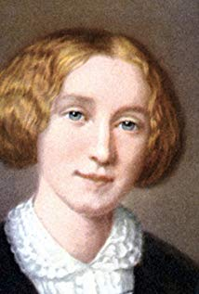
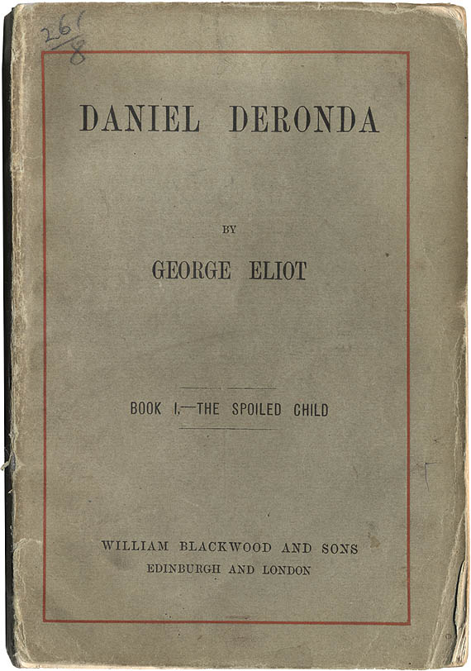
George Elliot
“If we are to consider the future of the Jews…are they destined to complete fusion with the peoples amongst whom they are disappeared; losing every remnant of a distinctive consciousness as Jews; or are there in the breadth and intensity with which the feeling of separateness, or what we may call the organised memory of a national consciousness, actually exists in the worldwide Jewish communities”
The Modern Hep Hep Hep (1878)
Is dualistic identity for ever?

Slide 7
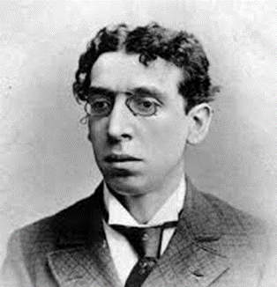
Israel Zangwill (1864 – 1926)
Born in London, son of immigrants
Jew’s Free School, University of London
Author: Children of The Ghetto (1892) Ghetto Tragedies (1899) Ghetto Comedies (1907) + many others
‘Transitional’ is one of the Ghetto Tragedies
Close friend of Theodor Herzl
Founded Jewish Territorial Organisation 1903 (IT0) after rejection of the Uganda proposal – became President

Slide 8
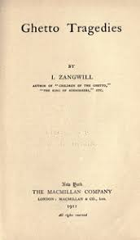
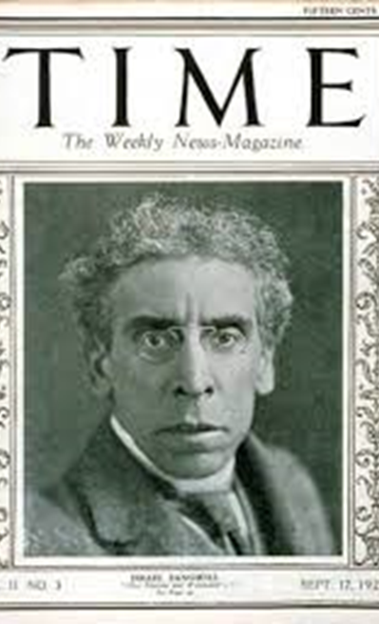
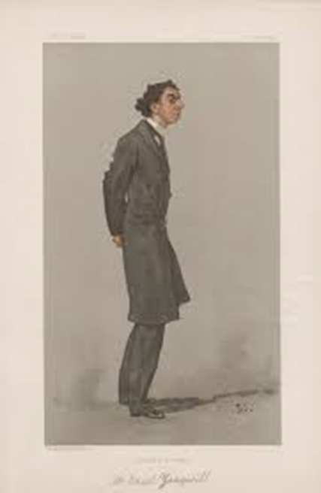

Slide 9
Zangwill’s Transitional - Synopsis
Jewish German father and Russian Mother settle and prosper in provincial town (Portsmouth)
They have 3 daughters, Leah Rachel and Rebecca, two sons who die, and then another four daughters: Sylvia, Lily, Daisy and Florence.
The mother insists on moving to “genteel Highbury in north London” to find suitable husbands
All the daughters are married off to nice Jewish boys until we hit the last, Florence, nicknamed Schnapsie by her father
She is discovered to be seeing a Christian boy. The father eventually, agrees to her marrying him because she is in love.
The father goes in a church
Schnapsie pulls the plug at the last minute, in a profound letter to her fiancé.
Does “Transitional “ refer to a Jewish family assimilating or to a new approach to inspiring Judaism?

Slide 10
The Letter
"You will say, let us again consent to wait for a contingency which I am not cold-blooded enough to set down more openly. [74]But I do not think it is fair to you to let you risk your happiness further by keeping it entangled with mine. A new current of thought has been set going in my mind. If a religion that I thought all formalism is capable of producing such types of abnegation as my dear father, then it must, too, somewhere or other, hold in solution all those ennobling ingredients, all those stimuli to self-sacrifice, which the world calls Christian. Perhaps I have always misunderstood. We were so badly taught. Perhaps the prosaic epoch of Judaism into which I was born is only transitional, perhaps it only belongs to the middle classes, for I know I felt more of its poetry in my childhood; perhaps the future will develop (or recultivate) its diviner sides and lay more stress upon the life beautiful, and thus all this blind instinct of isolation may prove only the conservation of the race for its nobler future, when it may still become, in very truth, a witness to the Highest, a chosen people in whom all the families of the earth may be blessed. I do not know; all this is very confused and chaotic to me to-night. I only know I can hold out no certain hope of the earthly fulfilment of our love. I, too, feel in transition, and I know not to what. But, dearest Alfred, shall we not be living the Christian life—the life of abnegation—more truly if we give up the hope of personal happiness? Forgive me, darling, the pain I am causing you, and thus help me to bear my own”.

Slide 11
The Letter
There is more to being Jewish than “formalism” – it must hold more
It must have enobling ingredients the world calls “Christian”
“We were taught so badly”
“Prosaic” Judaism is only transitional”
The “blind instinct of isolationism” versus laying stress on the beauty of life
Schnapsie too feels in transition
Christians and Jews have “abnegation”

Slide 12
The Detail – Wealth Equals Power? Identity?
The father is described as becoming President of his synagogue because of his money – his success in the outside world.
The younger daughters were all given “pagan” names because they complained as they grew up about their Jewish names.
Rebecca won’t marry a man with “carroty hair”
“As if in irony the Jewish group was blond, almost Christian….the pagan group had characteristically oriental traits”
“Leah, Rachel and Rebecca” (of course Leah is Rachel’s youngest sister), Rebecca is a generation earlier, Isaac’s wife

Slide 13
Religious Observance – Take I
The father’s prayer gradually reduces to “a pious mumbling” relegated….
The mother is lowered into “The House of Life”
All the married daughters admit to not fasting, none of the sons-in-law observe the shabbat – yet they tell on their sister

Slide 14
Religious Observance – Take 2
"How much Judaism is there in your sisters' husbands?" he said. "And without the religion, what is the use of the race?“
“ We have outlived our destiny, our isolation is a meaningless relic”
"I believe in self-sacrifice; that is Christianity.“
The nickname “Schnapsie”
The father goes to Church, having thought Christianity meant belief in three G-ds.
He tries hard, but can’t cope with the church service, but tries to “give in”
That night she writes the letter

Slide 15
Lessons?
It is arguably comforting that the dilemmas we face are not new
Jews have survived in Britain and elsewhere despite these
There ISN’T a magic answer any more than there is a single definition of Judaism
I am wary of “multiple truths” but not willing to criticise others and tolerant of their interpretations

Slide 16
Rabbi Hugo Gryn זיכרונו לברכה
“G-d save me from the man who KNOWS he is right”

